Slide 1


Maths at East Bergholt
Parent Forum
June 2024

Slide 2

Aims:
To explain the key aims of our maths curriculum here at East Bergholt.
To outline the concrete, pictorial and abstract approach to maths teaching and learning.
To offer information about maths at home.

Slide 3
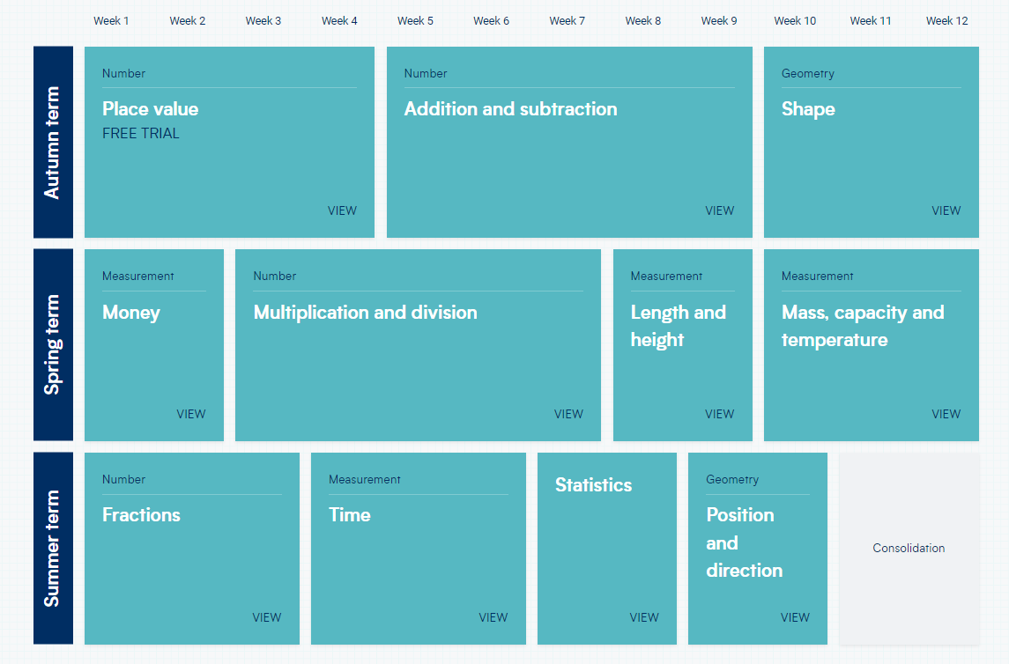
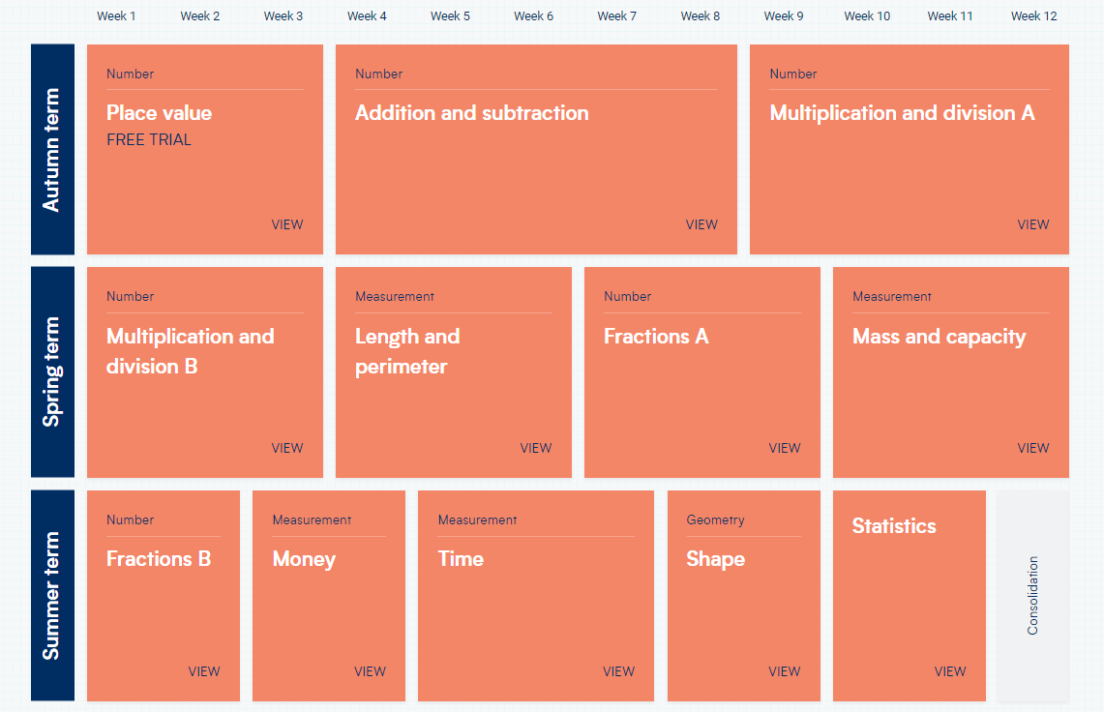
White Rose Maths
At East Bergholt Primary School, we want our pupils to become proficient mathematicians who have a broad understanding of what maths is, can confidently apply their knowledge and skills, have a sense of its everyday purpose and believe in their own capabilities.
White Rose Maths uses a mastery approach to maths, in that topics are taught in blocks made up of a number of small steps, which then build on one another through each year group.
Children make progress by developing their subject knowledge, consolidating and then applying their new learning to higher order thinking questions.
White Rose also uses a CPA (concrete, pictorial, abstract) approach.

Slide 4
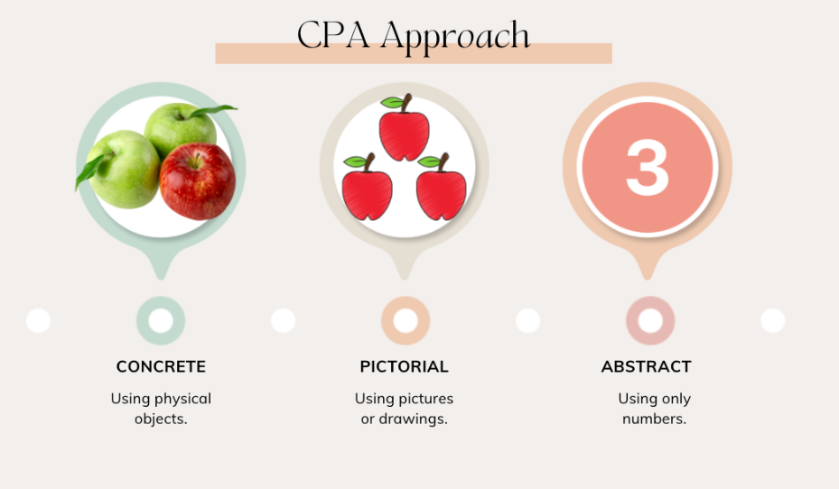
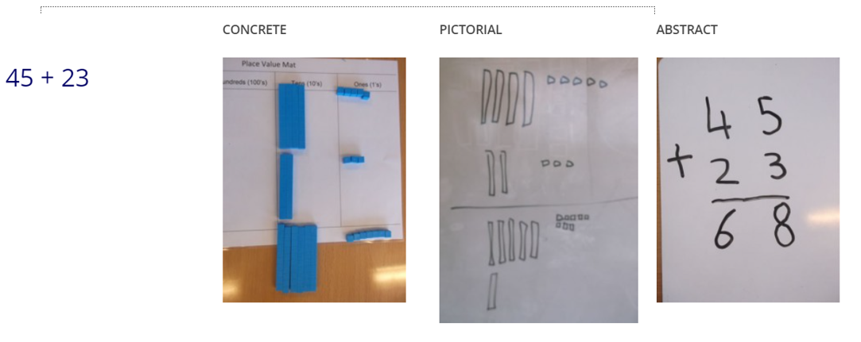
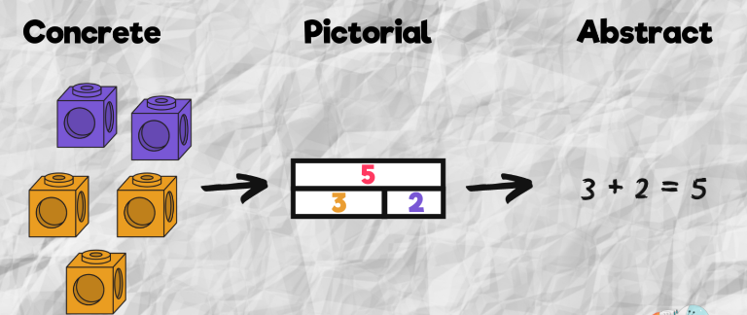
CPA

Slide 5
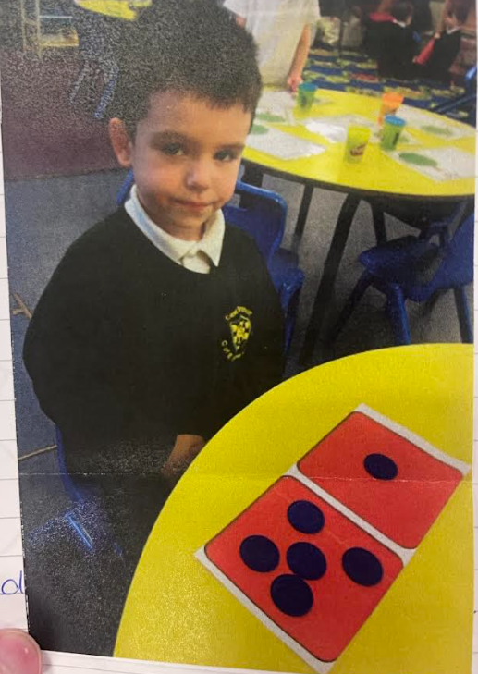
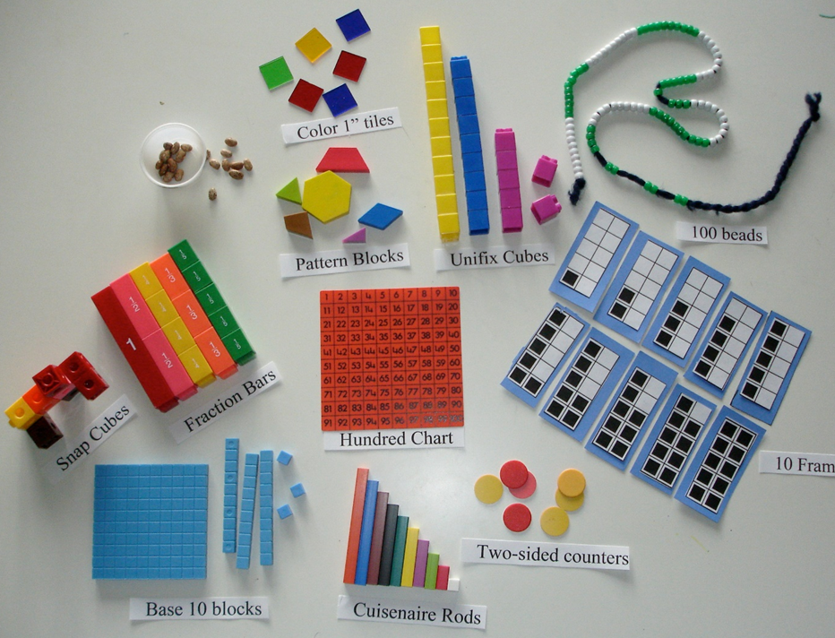
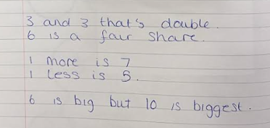
Concrete - use concrete objects and manipulatives to help children understand what they are doing.

Slide 6
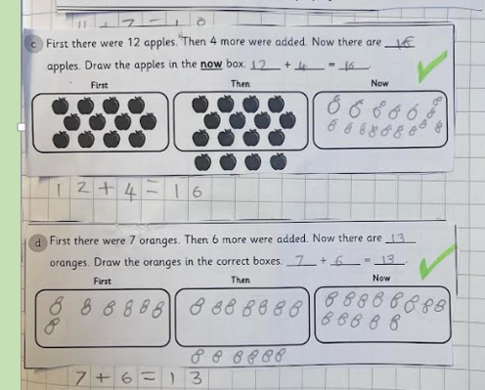
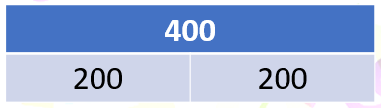
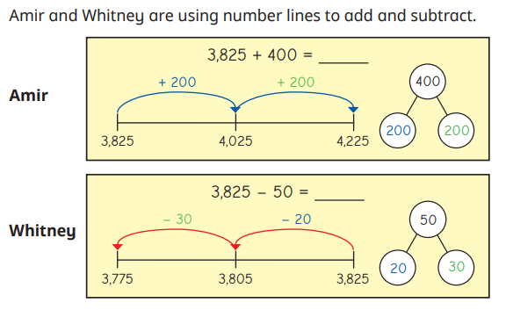
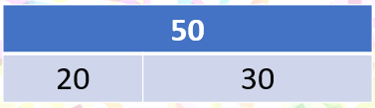
Pictorial
Bar Models
Number lines and Part whole models

Slide 7
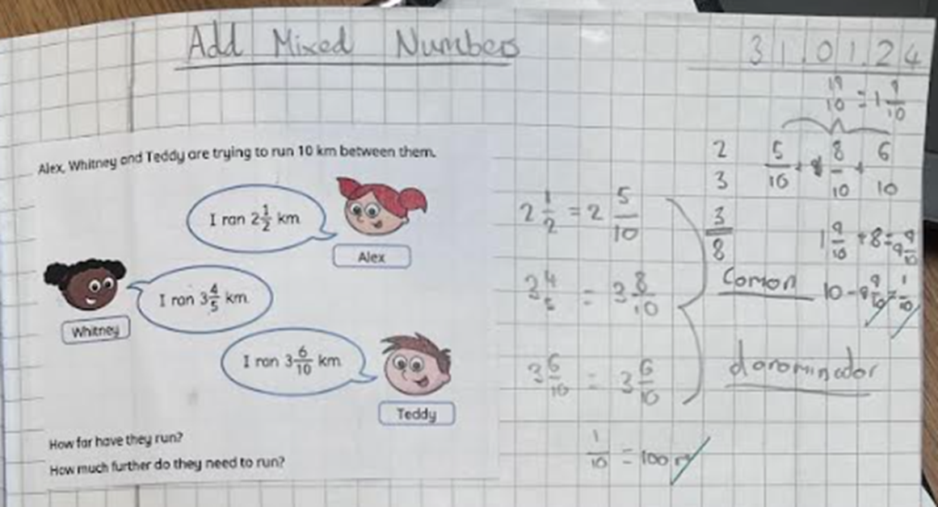
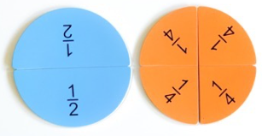
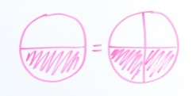
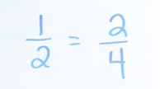
Abstract
This is when Children use digits and symbols to demonstrate their calculations and answers.
Depending on the lesson, content and year group, this is introduced at different points and is used alongside the Concrete and Pictorial part of the lesson.

Slide 8
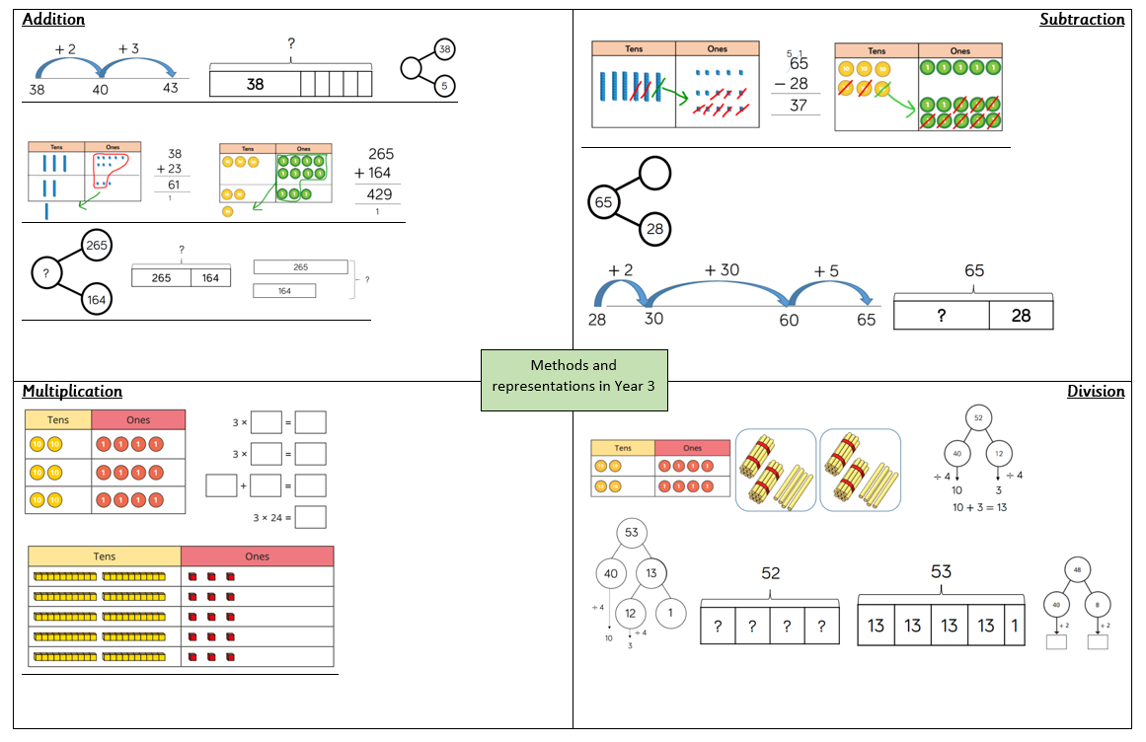
Calculation

Slide 9
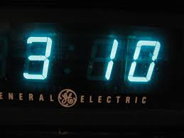
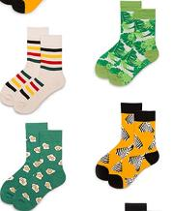

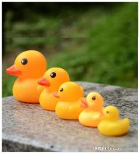
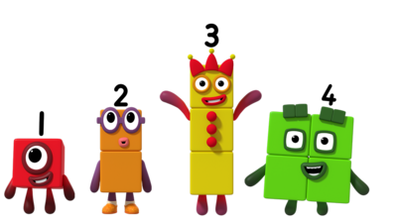
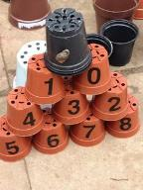
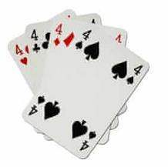
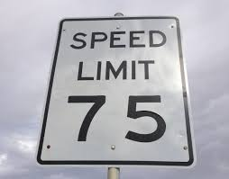
Supporting children at home
Maths is all around us!

Slide 10
‘I’ve never liked maths, I wasn’t any good at maths at school!’
Don’t worry! Maths does not need to be complicated. After all, it’s vital and used in our everyday lives. Just small actions can help build a love of number for your child. A positive mind-set and dialogue can ensure your child faces Mathematical challenges with grit and determination.
We are all mathematicians!

Slide 11
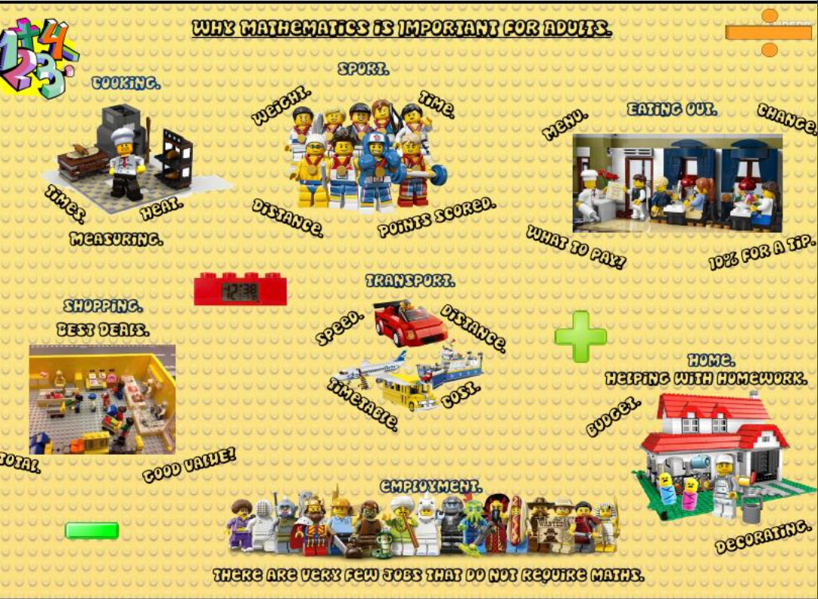

Slide 12
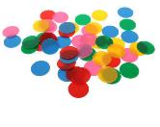
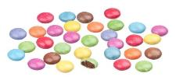
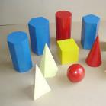
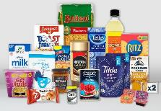
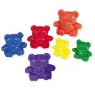
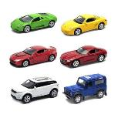

Maths at home
Counters or you could use…… Smarties
3D shapes or you could use…… groceries
Counting Bears or you could use…… anything you have a lot of!

Slide 13
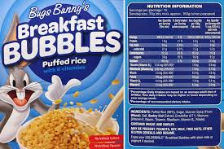
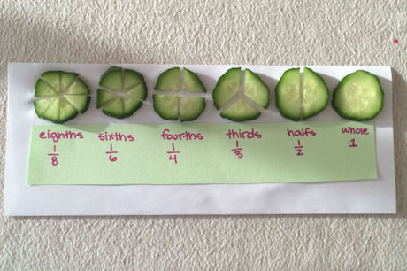
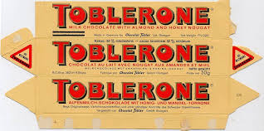
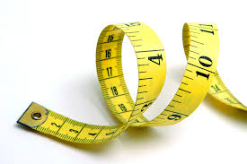
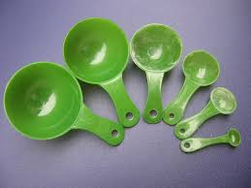
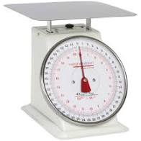
Maths at home
Using food to practically support with the understanding of fractions.
Food packaging around the home
Can be used for spotting numbers, adding numbers together and working out and reading percentages.
Using any measuring equipment
that you may have around the house
to practise reading a variety of scales.
Packaging can be used to support with understanding 3D shapes and their nets.

Slide 14
Maths at home – Times tables
Times tables are the foundation of mathematical learning and are the building blocks upon which other mathematical thinking is built.
There are two overwhelming reasons why we need children to prioritise learning their times tables:
1. Times tables are fundamental to many maths topics
Fractions is the most obvious area where learning times tables well is essential. However, every multiplication, division, long multiplication method and short division and long division method require speed and instant recall of times tables.
Times tables are central to KS2 Maths and need to be embedded by Year 4 in order for pupils to practice and cement this skill. Otherwise, pupils will struggle as they move up Key Stage 2 and prepare for their KS2 SATs and beyond.
2. Freeing up working memory allows pupils to develop their reasoning skills
There are certain mental maths facts and operations children need to be able to carry out quickly and with a degree of automaticity in order to free up their working memory for newer, more challenging tasks at hand.
If we can ensure the transition of times tables facts to children’s long term memory and times tables can become an instantly recallable fact the working memory can be freed up for reasoning.

Slide 15
Times tables
Start small – set a target to learn one set of times table – don’t be overwhelmed by learning them all at once;
  First Step: Learning to count in 2’s
  This allows children to begin to see the pattern that multiplication is repeated addition (KS1)
  Second Step: Beginning the memorisation process
  When beginning to memorise, start with the times tables facts for 1 x 2, 5 x 2 then 10 x 2. Starting with these each time helps build confidence
  Third Step: Building up
  Start building up the memorisation of the times tables, can you spot a relationship between the numbers? 2 x 2 and 4 x 2? Does that make working out 8 x 2 easier to work out/memorise?
  Fourth Step: Practice
  Start by practising them in order, progressing to out of order. Play games to help build fluency and soon your child’s confidence will follow.

Slide 16
MTC – Multiplication Tables Check - What is it?
It is a Year 4 statutory test
25 questions in the format 6 X 5 =
no gaps eg 6 X ? = 30
6 seconds to answer each question
there is an emphasis on the 6, 7, 8, 9 and 12 multiplication tables because these have been determined to be the most difficult multiplication tables
we will share your child’s results with you on their Summer term report.

Slide 17
Maths at Home – Key instant recall facts
Key Instant Recall Facts, commonly known as KIRFs, are fundamental mathematical facts that children need to master during their primary school years. These facts include essential skills such as number bonds and times tables, which are critical for developing a solid foundation in mathematics.
KIRFs play a vital role in helping children perform calculations with ease and confidence. Whether they are adding, subtracting, multiplying, or dividing, having these facts at their fingertips can significantly improve their speed and accuracy. Moreover, KIRFs underpin many other areas of mathematics, supporting children in more complex problem-solving and reasoning tasks.
By regularly practicing these KIRFs, your child will build a robust mathematical foundation that will benefit them throughout their education. Use games, flashcards, or everyday situations to make learning these facts enjoyable and engaging. Happy learning!

Slide 18
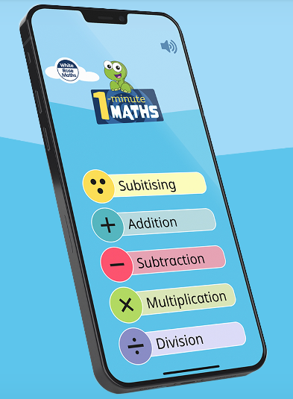



At Home…

