Slide 1

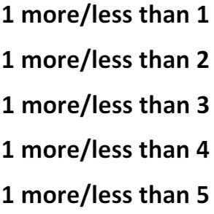
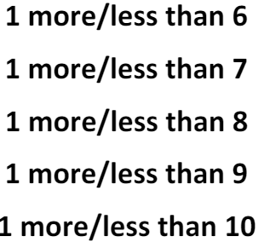
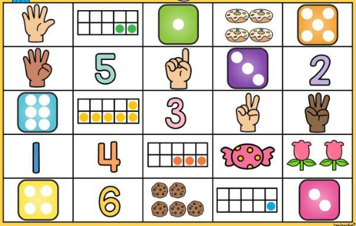
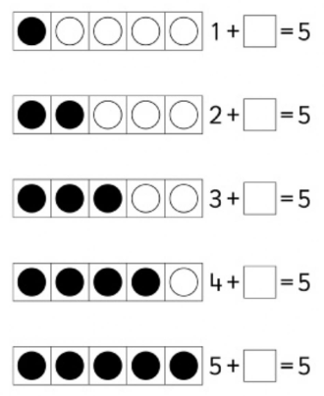
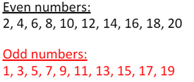
Key Instant Recall Facts - EYFS
At the end of Autumn term…
At the end of Spring term…
At the end of Summer term…
I can count numbers to 20
I can say the numbers from 0 to 10 and back from 10 to 0 in order
I can say 1 more and 1 less (numbers to 10)
Children should be able to count (in order) and read from 0 to 20 in numerals (not words). Children should know what number comes next, e.g. 17 comes after 16. Children should also know what number comes before a number, e.g. 12 comes before 13.
Ascending: 0,1,2,3,4,5,6,7,8,9,10
Descending: 10,9,8,7,6,5,4,3,2,1,0
By the end of this year, children should know the following facts. The aim is for them to recall these facts instantly.
I know doubles up to 5 + 5
I can recognise quantities, without counting, up to 5.
0 + 0 = 0
1 + 1 = 1
2 + 2 = 4
3 + 3 = 6
4 + 4 = 8
5 + 5 = 10
I can recall number Bonds to and within 5
1+0 = 1
0 +1 = 1
1 + 1 = 2
2 + 0 = 2
1 + 2 = 3
3 + 0 = 3
1 + 3 = 4
2 + 2 = 4
4 + 0 = 4
5 + 0 = 5
1 + 4 = 5
2 + 3 = 5
Top Tips
The secret to success is practising little and often. Use time wisely. Can you practise these KIRFs while walking to school or during a car journey? You don’t need to practise them all at once: perhaps you could have a fact of the day. If you would like more ideas, please speak to your child’s teacher.
I know some odd and even numbers

Slide 2







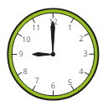
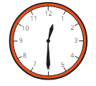
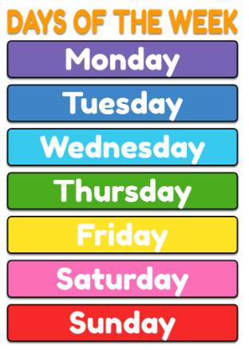
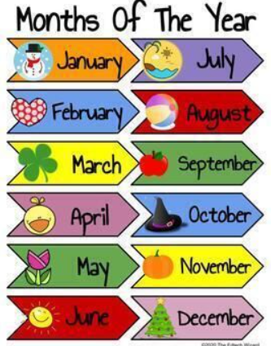

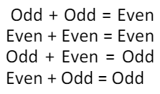
Key Instant Recall Facts - Year 1
At the end of Autumn term…
At the end of Spring term…
At the end of Summer term…
I know number bonds for each number within 10.
I know doubles and halves of numbers to 10.
I can tell the time.
0 + 0 = 0 1 + 1 = 1 2 + 2 = 4 3 + 3 = 6 4 + 4 = 8 5 + 5 = 10 6 + 6 = 12 7 + 7 = 14 8 + 8 = 16 9 + 9 = 18 10 + 10 = 20 | ½ of 0 = 0 ½ of 2 = 1 ½ of 4 = 2 ½ of 6 = 3 ½ of 8 = 4 ½ of 10 = 5
Children need to be able to tell the time using a clock with hands. This target can be broken down into several steps.
I can tell the time to the nearest hour.
I can tell the time to the nearest half hour.
I know number bonds to 20.
0 + 20 = 20 1 + 19 = 20 2 + 18 = 20 3 + 17 = 20 4 + 16 = 20 5 + 15 = 20 6 + 14 = 20 7 + 13 = 20 8 + 12 = 20 9 + 11 = 20 10 + 10 = 20 | 20 + 0 = 20 19 + 1 = 20 18 + 2 = 20 17 + 3 = 20 16 + 4 = 20 15 + 5 = 20 14 + 6 = 20 13 + 7 = 20 12 + 8 = 20 11 + 9 = 20 | 20 – 0 = 20 20 – 1 = 19 20 – 2 = 18 20 – 3 = 17 20 – 4 = 16 20 – 5 = 15 20 – 6 = 14 20 – 7 = 13 20 – 8 = 12 20 – 9 = 11 20 – 10 = 10 | 20 – 20 = 0 20 – 19 = 1 20 – 18 = 2 20 – 17 = 3 20 – 16 = 4 20 – 15 = 5 20 – 14 = 6 20 – 13 = 7 20 – 12 = 8 20 – 11 = 9
Children should be able to answer these questions in any order, including missing number questions e.g. 1 + ⃝ = 10 or 9 – ⃝ = 8.
I know the days of the week and the months of the year.
I know number bonds to 10.
0 + 10 = 10 10 + 0 = 10 10 – 10 = 0 10 – 0 = 10 1 + 9 = 10 9 + 1 = 10 10 – 9 = 1 10 – 1 = 9 | 2 + 8 = 10 8 + 2 = 10 10 – 8 = 2 10 – 2 = 8 3 + 7 = 10 7 + 3 = 10 10 – 7 = 3 10 – 3 = 7 | 4 + 6 = 10 6 + 4 = 10 10 – 6 = 4 10 – 4 = 6 5 + 5 = 10 10 – 5 = 5
I know odd and even numbers to 20
Top Tips
The secret to success is practising little and often. Use time wisely. Can you practise these KIRFs while walking to school or during a car journey? You don’t need to practise them all at once: perhaps you could have a fact of the day. If you would like more ideas, please speak to your child’s teacher.
Use practical resources – Your child has one potato on their plate and you give them two more. Can they predict how many they will have now?
Play games – You can play number bond pairs online at https://www.topmarks.co.uk/maths-games/daily10 and on the app ‘One Minute Maths’ by White Rose.
I can count forwards and backwards in steps of 2,5 and 10
2s: 0,2,4,6,8,10,12,14,16,18,20 etc.
5s: 0,5,10,15,20,25,30,35,40,45,50 etc.
10s: 10,20,30,40,50,60,70,80,90,100 etc.

Slide 3
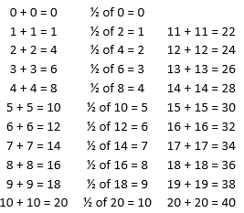
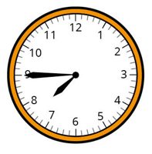
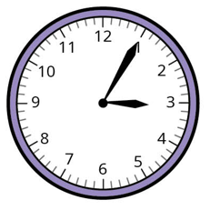


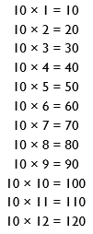



Key Instant Recall Facts - Year 2
At the end of Autumn term…
I know doubles and halves of numbers to 20.
At the end of Summer term…
I can tell the time.
I know addition and subtraction facts for multiples of 10 to 100.
Children need to be able to tell the time using a clock with hands. This target can be broken down into several steps.
I can tell the time to the nearest hour.
I can tell the time to the nearest half hour.
I can tell the time to the nearest quarter hour.
I can tell the time to the nearest five minutes.
10 + 90 = 100
20 + 80 = 100
30 + 70 = 100
40 + 60 = 100
50 + 50 = 100
100 – 10 = 90
100 – 20 = 80
100 - 30 = 70
100 – 40 = 60
100 – 50 = 50
100 – 90 = 10
100 - 80 = 20
100 – 70 = 30
100 – 60 = 40
Top Tips
The secret to success is practising little and often. Use time wisely. Can you practise these KIRFs while walking to school or during a car journey? You don’t need to practise them all at once: perhaps you could have a fact of the day. If you would like more ideas, please speak to your child’s teacher.
Songs and Chants – You can buy Times Tables CDs or find multiplication songs and chants online. If your child creates their own song, this can make the times tables even more memorable.
Spot patterns – What patterns can your child spot in the 5 times table? Are there any similarities with the 10 times table?
Test the Parent – Your child can make up their own tricky division questions for you e.g. What is 45 divided by 5? They need to be able to multiply to create these questions.
Use memory tricks – For those hard-to-remember facts, www.multiplication.com has some strange picture stories to help children remember.
At the end of Spring term…
I know the multiplication and division facts for the 2 times table.
I know the multiplication and division facts
for the 10 times table.
I know the multiplication and division facts for the 5 times table.
Children should be able to answer these questions in any order, including missing number questions e.g. 2 × ⃝ = 8 or ⃝ ÷ 2 = 6.
Children should be able to answer these questions in any order, including missing number questions e.g. 10 × ⃝ = 80 or ⃝ ÷ 10 = 6.

Slide 4
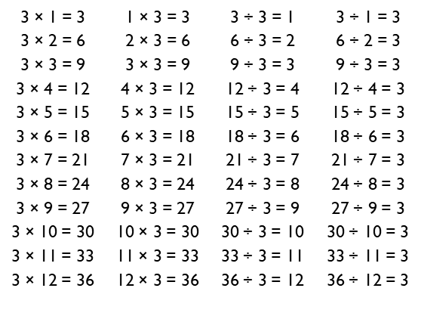
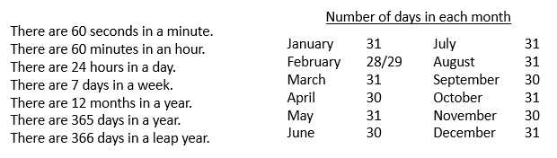
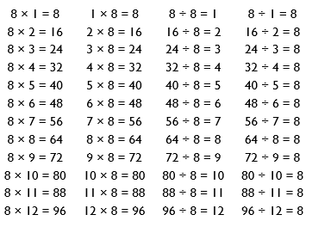
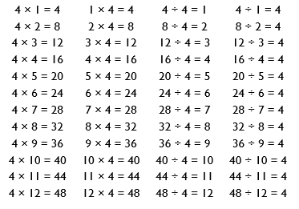
Key Instant Recall Facts - Year 3
At the end of Autumn term…
At the end of Spring term…
At the end of Summer term…
I know number bonds for all numbers within 20.
I know the multiplication and division facts for the 3 times table.
I can recall facts about durations of time.
2 + 9 = 11 3 + 8 = 11 4 + 7 = 11 5 + 6 = 11 3 + 9 = 12 4 + 8 = 12 5 + 7 = 12 6 + 6 = 12 4 + 9 = 13 5 + 8 = 13 6 + 7 = 13 | 5 + 9 = 14 6 + 8 = 14 7 + 7 = 14 6 + 9 = 15 7 + 8 = 15 7 + 9 = 16 8 + 8 = 16 8 + 9 = 17 9 + 9 = 18 | Example of a fact family 6 + 9 = 15 9 + 6 = 15 15 – 9 = 6 15 – 9 = 6 Examples of other facts 4 + 5 = 9 13 + 5 = 18 19 – 7 = 12 10 – 6 = 4
This list includes the most challenging facts but children will need to learn all number bonds for each number to 20 (e.g. 15 + 2 = 17). This includes related subtraction facts (e.g. 17 – 2 = 15).
They should be able to answer these questions in any order, including missing number questions e.g. 3 × ⃝ = 18 or ⃝ ÷ 3 = 11.
I know the multiplication and division facts for the 8 times table.
I know the multiplication and division facts for the 4 times table.
Top Tips
The secret to success is practising little and often. Use time wisely. Can you practise these KIRFs while walking to school or during a car journey? You don’t need to practise them all at once: perhaps you could have a fact family of the day. If you would like more ideas, please speak to your child’s teacher.
Songs and Chants – You can buy Times Tables CDs or find multiplication songs and chants online. If your child creates their own song, this can make the times tables even more memorable.
Double your fours – Multiplying a number by 8 is the same as multiply by 4 and then doubling the answer. 8 × 4 = 32 and double 32 is 64, so 8 × 8 = 64.
Five six seven eight – fifty-six is seven times eight (56 = 7 × 8).
Use memory tricks – For those hard-to-remember facts, www.multiplication.com has some strange picture stories to help children remember.

Slide 5
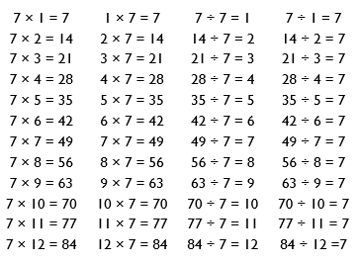
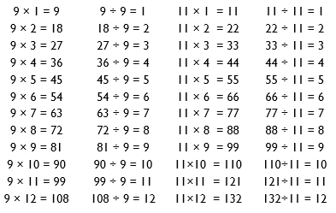
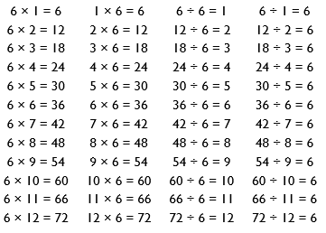
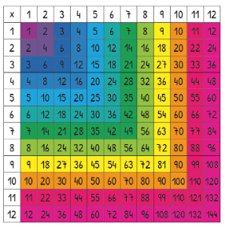
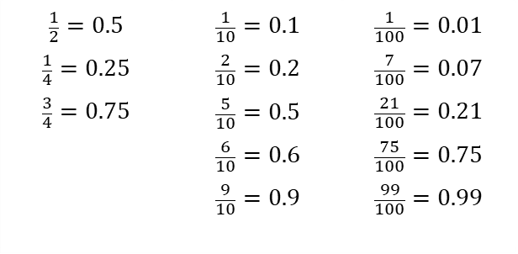
Key Instant Recall Facts - Year 4
At the end of Autumn term…
At the end of Spring term…
At the end of Summer term…
I know number bonds to 100.
I know the multiplication and division facts for the 9 and 11 times tables.
I know the multiplication and division facts for the 7 times table.
Some examples: 60 + 40 = 100 40 + 60 = 100 100 – 40 = 60 100 – 60 = 40 75 + 25 = 100 25 + 75 = 100 100 – 25 = 75 100 – 75 = 25 | 37 + 63 = 100 63 + 37 = 100 100 – 63 = 37 100 – 37 = 63 48 + 52 = 100 52 + 48 = 100 100 – 52 = 48 100 – 48 = 52
Top Tips
The secret to success is practising little and often. Use time wisely. Can you practise these KIRFs while walking to school or during a car journey? You don’t need to practise them all at once: perhaps you could have a fact family of the day. If you would like more ideas, please speak to your child’s teacher.
I know the multiplication and division facts for the 6 times table.
I know decimal equivalents of fractions.
I know the multiplication and division facts for all times tables up to 12 × 12 .
$$\frac{1}{2}=0.5$$ $$\frac{1}{4}=0.25$$ $$\frac{3}{4}=0.75$$ | $$\frac{1}{10}=0.1$$ $$\frac{2}{10}=0.2$$ $$\frac{5}{10}=0.5$$ $$\frac{6}{10}=0.6$$ $$\frac{9}{10}=0.9$$ | $$\frac{1}{100}=0.01$$ $$\frac{7}{100}=0.07$$ $$\frac{21}{100}=0.21$$ $$\frac{75}{100}=0.75$$ $$\frac{99}{100}=0.99$$
Children should be able to convert between decimals and fractions for ½, ¼, ¾ and any number of tenths and hundredths.

Slide 6
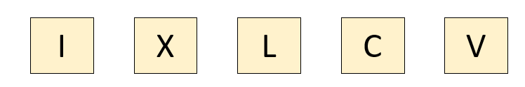
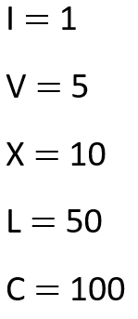
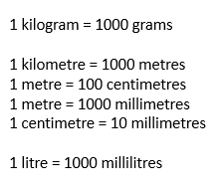
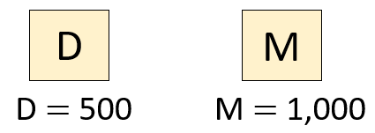
Key Instant Recall Facts - Year 5
At the end of Autumn term…
At the end of Spring term…
At the end of Summer term…
I know the multiplication and division facts for all times tables up to 12 × 12 .
I can identify prime numbers up to 20.
I know decimal number bonds to 1 and 10.
A prime number is a number with only two factors: itself and one.
The following numbers are prime numbers:
2, 3, 5, 7, 11, 13, 17, 19
Some examples: 0.6 + 0.4 = 1 0.4 + 0.6 = 1 1 – 0.4 = 0.6 1– 0.6 = 0.4 0.75 + 0.25 = 1 0.25 + 0.75 = 1 1 – 0.25 = 0.75 1 – 0.75 = 0.25 | 3.7 + 6.3 = 10 6.3 + 3.7 = 10 10 – 6.3 = 3.7 10 – 3.7 = 6.3 4.8 + 5.2 = 10 5.2 + 4.8 = 10 10 – 5.2 = 4.8 10 – 4.8 = 5.2
I can recall square numbers up to 12²
1² = 1 × 1 = 1
2² = 2 × 2 = 4
3² = 3 × 3 = 9
4² = 4 × 4 = 16
5² = 5 × 5 = 25
6² = 6 × 6 = 36
7² = 7 × 7 = 49
8² = 8 × 8 = 64
9² = 9 × 9 = 81
10² = 10 × 10 = 100
11² = 11 × 11 = 121
12² = 12 × 12 = 144
This list includes some examples of facts that children should know. They should be able to answer questions including missing number questions e.g. 0.49 + ⃝ = 10 or 7.2 + ⃝ = 10.
I know how to represent numbers to 1000 using Roman numerals.
I can recall metric conversions.
They should also be able to apply these facts to answer questions.
e.g. How many metres in 1½ km?
Top Tips
The secret to success is practising little and often. Use time wisely. Can you practise these KIRFs while walking to school or during a car journey? You don’t need to practise them all at once: perhaps you could have a fact of the day. If you would like more ideas, please speak to your child’s teacher.
Cycling Squares – At http://nrich.maths.org/1151 there is a challenge involving square numbers. Can you complete the challenge and then create your own examples?
Use memory tricks – For those hard-to-remember facts, www.multiplication.com has some strange picture stories to help children remember.

Slide 7
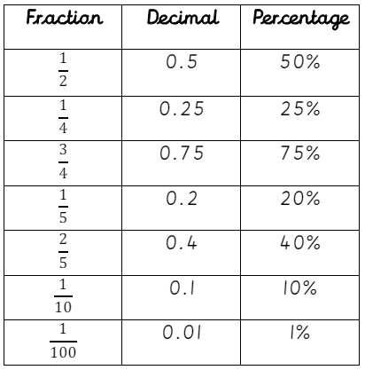
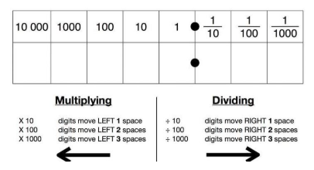
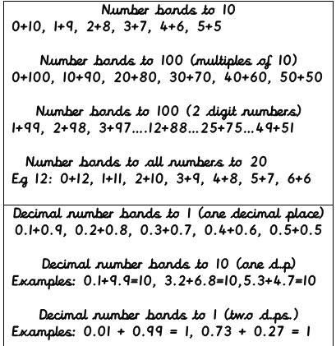
Key Instant Recall Facts - Year 6
At the end of Autumn term…
At the end of Spring term…
At the end of Summer term…
I know the multiplication and division facts for all times tables up to 12 × 12 .
I can identify prime numbers up to 50.
I know doubles and halves of all 2-digit numbers including 2-digit decimals
A prime number is a number with no factors other than itself and one.
The following numbers are prime numbers:
2, 3, 5, 7, 11, 13, 17, 19, 23,
29, 31, 37, 41, 43, 47
Examples: 77 x 2 =154
54 + 54 = 108
Double 37 = 74
77 ÷ 2 =38.5
48 – 24 = 24
Half of 89 = 44.5
4.8 x 2 =9.6
6.1 + 6.1 = 12.2
Double 15.2 = 30.4
4.8 ÷ 2 =2.4
60.3 – 30.15 =30.15
Half 1.8 = 0.9
22.45 x 2 = 44.9
60.22 ÷ 2 = 30.11
I can convert between fractions, decimals and percentages.
Multiply and divide whole and decimal numbers by 10, 100 and 1000.
I can recall all number bonds including decimals that total 1 or 10 (two decimal places)
Top Tips
The secret to success is practising little and often. Use time wisely. Can you practise these KIRFs while walking to school or during a car journey? You don’t need to practise them all at once: perhaps you could have a fact family of the day. If you would like more ideas, please speak to your child’s teacher.
When we multiply by 10, 100 and 1000 we shift the digits to the left. One place left for 10, two places left for 100 and three places left for 1000. When we divide by 10, 100 and 1000, we do the opposite and shift the digits to the right instead.
Children should be able to convert between decimals and fractions for ½, ¼, ¾ and any number of tenths and hundredths.

