Slide 1

East Bergholt Primary School - Reception Information Evening 2025

Slide 2

Parents as partners!
At East Bergholt Primary School we know that you know your child best
Open door policy
Book appointments via the office
2x parent evenings during the year and
an end of year report

Slide 3
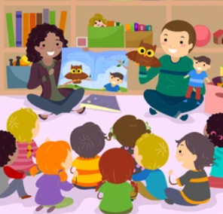
Transition
This morning we welcomed the children into our classroom.
The children also met their buddies
Transition book has been given to you
This Includes:
*Pictures of school and classroom
*Pictures of adults and a little about
them

Slide 4
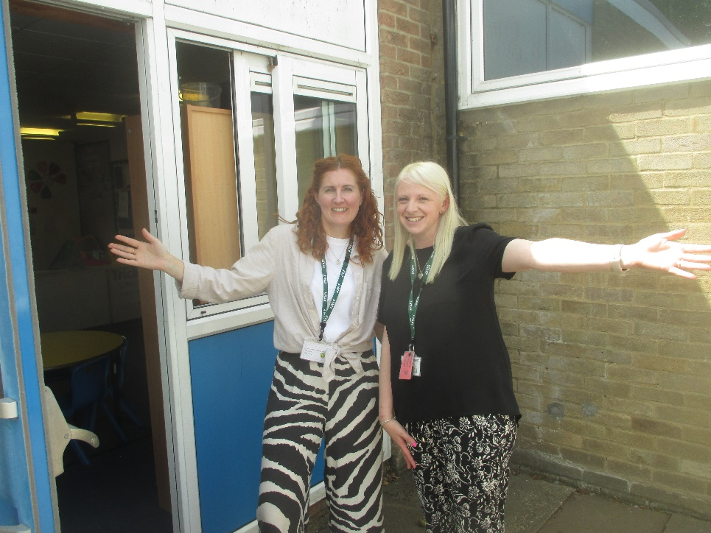
Typical School day- Morning
- Doors open at 8:45am
- Register-8.55am
- Choosing our own learning/Maths
- Milk/water
- Phonics
- Playtime – with KS1
- Reading practise session
- Lunch – 11:45 am

Slide 5
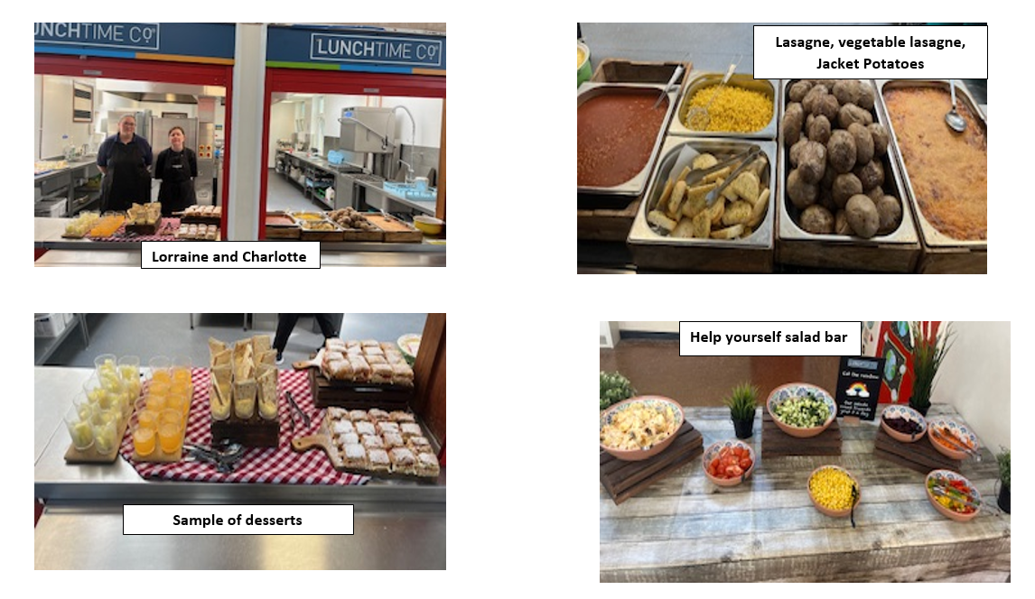
Lunch

Slide 6
Typical School Day- Afternoon
- Register
Choosing my own learning/Literacy
Snack
-PE, Music, Art, RE, Science etc.
- Assembly
Home time!
*For the first half term pick up will be 3:15 to help support transitions. After the October half term this is will be 3:20*

Slide 7
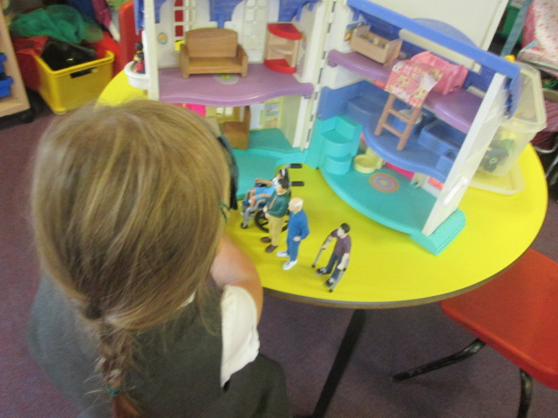
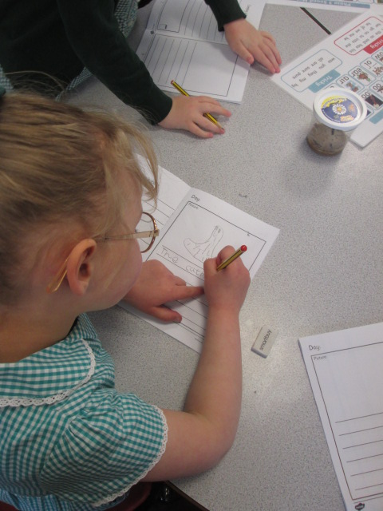
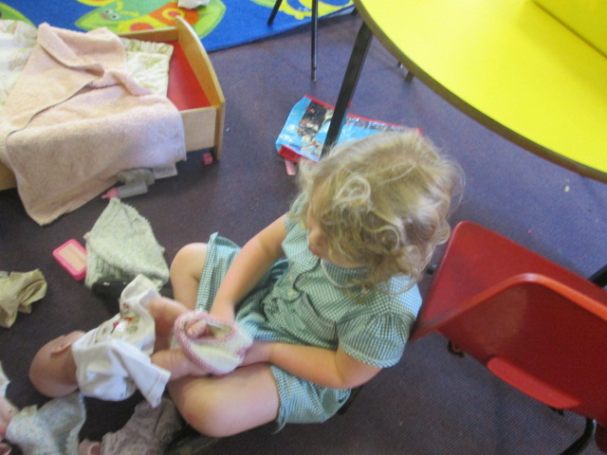
Indoor activities:
Arts and crafts
Construction
Small world
Reading area
Puzzles
Writing area
Play dough
Home corner/dressing up
Topic related role play area

Slide 8
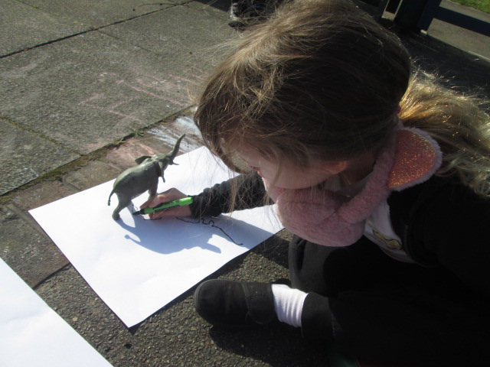
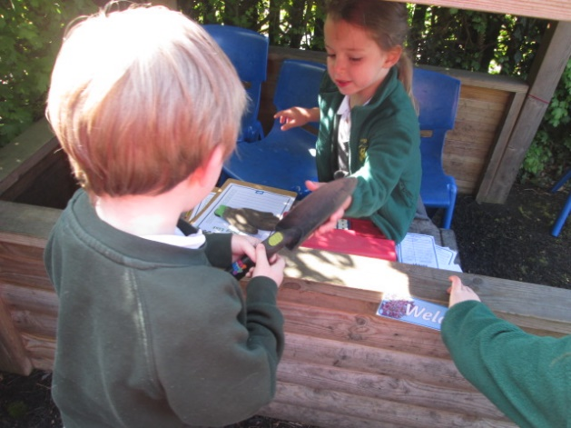
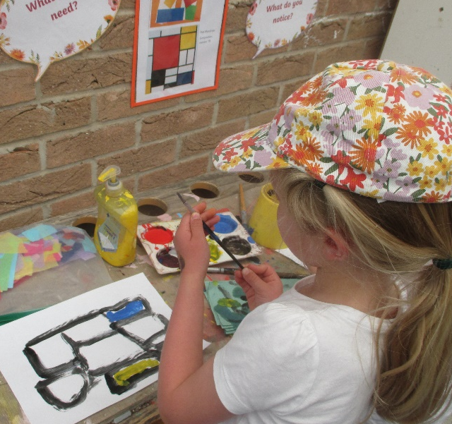
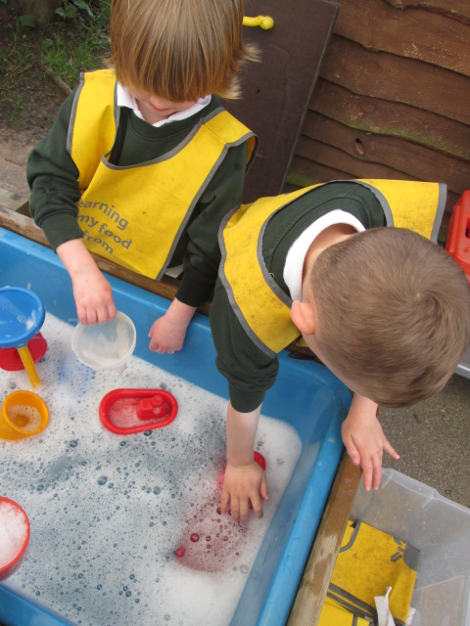
Outdoor activities:
Den building
Team games
Sand and water
Gardening
Bikes and scooters
Painting/chalking
Mud kitchen
Roleplay
Outdoor construction

Slide 9
What is Phonics?
Making connections between the sounds of our spoken words and the letters that are used to write them down.
The children start learning to recognise graphemes from the second week of school. We also teach the children to blend.

Slide 10

Tapestry
Online learning journey
Parents can have access to it at home.
Observations and photographs of the children’s learning.
Parent comments.

Slide 11

Homework
1 reading book matched to the children’s phonics ability and 1 shared reading book a week.
Phonics/tricky word activities

Slide 12

What will my child need to bring to school?
Named PE kit. (clothes suitable for both indoor and outdoor activities)
Children will be placed in coloured teams
Named water bottle
Coat/sunhat
Book bag/bag

Slide 13
What does my child need to practise over the Summer?
Getting themselves changed independently
Toileting
Recognising their own name
Writing their own name
Fine motor skills
Identifying the initial sounds in words
Verbally blending simple spoken words

Slide 14
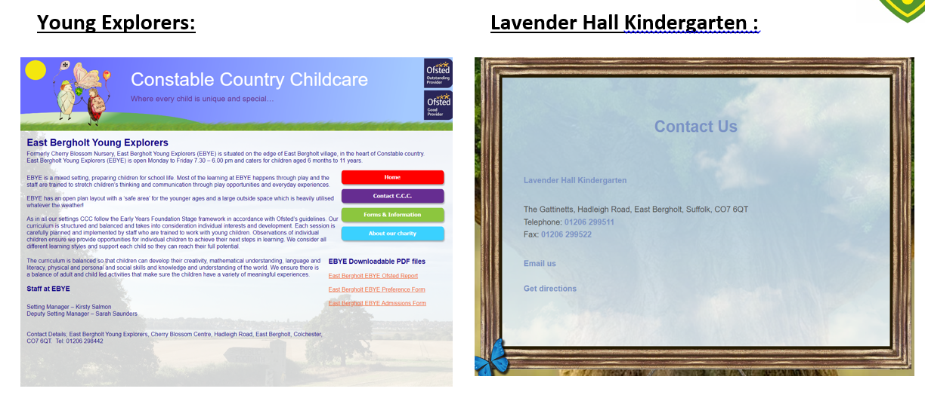
Wrap around care

Slide 15
Useful information
Register- 8.55am (doors open at 8.45am)
Initial school finish time of 3.15pm (children to be picked up on the key stage one playground)
Communication is mainly done through emails and texts through the office
PE kits need to remain in school for the half term
Universal free school meals for all children until the end of Year 2

Slide 16



Preparing Your Child for Starting School
Starting school is an exciting milestone – but we know it can feel a little daunting too. There are lots of simple, reassuring ways you can help your child get ready for this big adventure. One lovely way is by sharing stories together about what school is like.
Here are three brilliant books to enjoy with your child:

Slide 17


Questions?

