Slide 1
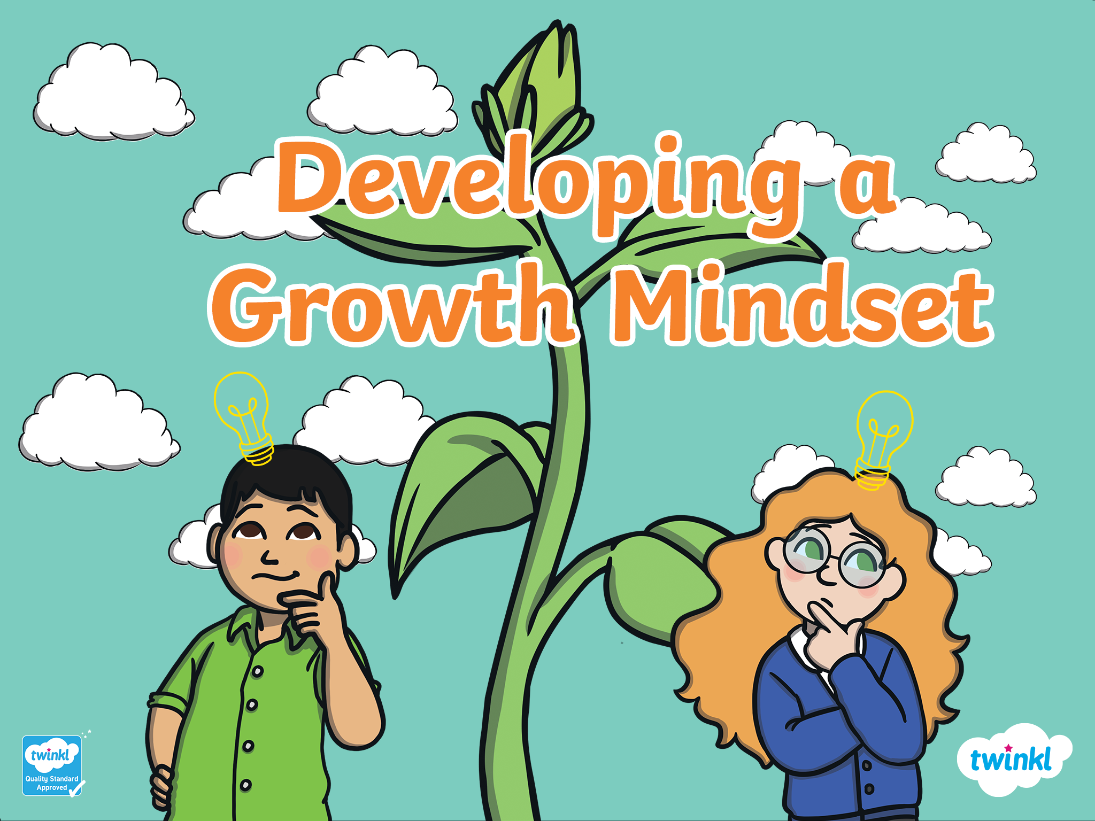



Slide 2





Mindset
A mental attitude that determines how you will interpret and respond to situations.
Today we are going to think about mindset.
Your mindset is all about your attitude.
It is about how you think and feel, rather than what you can or cannot do.

Slide 3

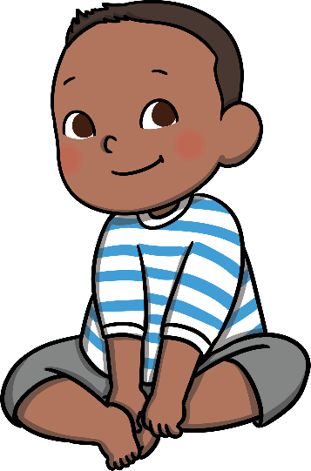
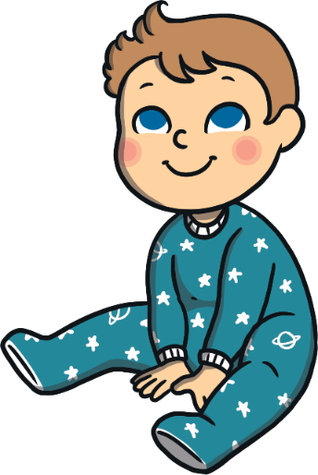


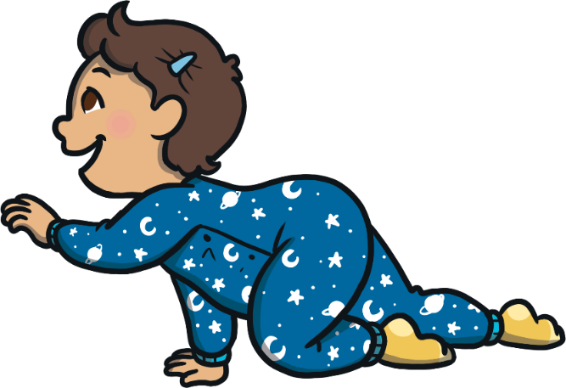
Babies are always trying new things.
They have to learn to do everything!

Slide 4


But as we get older, we find it hard to stay positive about trying new things.
It can make us sad if we make mistakes.

Slide 5
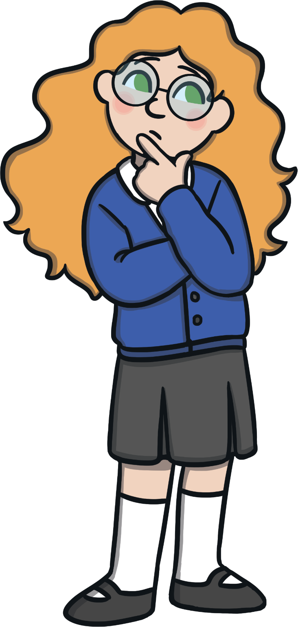
People used to believe that…
No matter how much you learn or how hard you work, your intelligence stays the same!
Scientists believed that you could not change how clever you are, or what you can achieve.
It was thought that you could not change this, no matter what your attitude was.

Slide 6
Now we believe that…
Mindset matters!
In 2008, scientists found that geniuses are more likely to have a positive attitude.
Geniuses are not born brilliant – they are really good at keeping trying when things are tricky, and trying new things to make their work better.

Slide 7


In other words…
It’s not what you are born with that matters; it’s your mindset that matters!
You can be as brilliant as anybody else – you just need the right attitude. You can be a genius, if you believe you can!

Slide 8

At East Bergholt we want to be…
Hard-working
Harvi

Slide 9

At East Bergholt we want to be…
Persistent
Peri

Slide 10

At East Bergholt we want to be…
Motivated
Moti

Slide 11

At East Bergholt we want to be…
Resilient
Rez

Slide 12
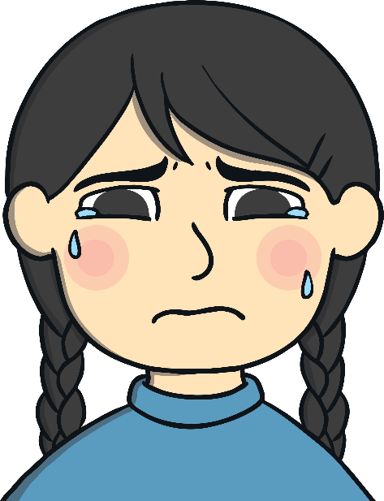

Change Your Mindset
‘This is tricky –
that means I must be learning!’
What could she say instead?
If I make a mistake,
I can try again.’
‘I can’t do it.’
‘I could ask my teacher to explain it to me so that I can do it.’
Persistent
Resilient

Slide 13
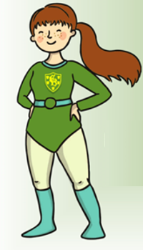

Change Your Mindset
What could he say instead?
‘I’ll never be able to do this.’
‘If I keep trying, I will get better at this.’
‘I will be happy when
I learn to do this.’
‘Even if I make a little improvement, that is a big achievement for me.’
Motivated

Slide 14

Change Your Mindset
What could she say instead?
‘My friend is really good at this. I wonder if they could show me how to do it.’
‘My friend is a million times better at this than me. I feel like giving up’
‘Everybody is good at different things. I’ll keep trying’
Hard-working

Slide 15

Change Your Mindset

Slide 16
Change Your Mindset
Try this today!
Each week we will celebrate one person in each class who has used their learning superpowers.

Slide 17

New Certificates

